Slide 1
Text Sentiment Analysis
Xihao liang

Slide 2
Semi-supervised Sentiment Classification with Dialog Data (2018)
Abstract
Recent studies showed that pretraining with unlabeled data via a language model can improve the performance of classification models.
In this paper, we take the concept a step further by using a conditional language model, instead of a language model.
Specifically, we address a sentiment classification task for a tweet analysis service as a case study and propose a pretraining strategy with unlabeled dialog data (tweet-reply pairs) via an encoder-decoder model.
Our pretraining strategy simply consists of the following two steps:
1. Training a dialog (encoder-decoder) model using unlabeled dialog data (tweet-reply pairs) as pretraining.
predicts a correct output sequence from an input sequence [Sutskever et al. 2014].
2. Training a sentiment classifier (encoder-labeler) model using labeled sentiment data (tweet-label pairs) after initializing its encoder part with the encoder parameters of the encoder-decoder model.
Author: Toru Shimizu, Hayato Kobayashi, Nobuyuki Shimizu
The 32nd Annual Conference of the Japanese Society for Artificial Intelligence, 2018

Slide 3
Emotion Analysis of Internet Chat (2008)
Abstract
We present a system for Emotion Analysis of Instant Messages (IM).
Tagged instant messages and elaborate feature engineering can help a lot in increasing the performance of text classification of unstructured, ungrammatical text.
The impact of class imbalance on classification has been studied and demonstration has been made of how under-sampling (欠采样) can help mitigate this problem.
Data Acquisition
A bigger dataset of 10567 sentences is the NPS (Naval Post Graduate School) chat corpus.
Out of these only 7933 sentences, which were part of conversation
A smaller set of 2980 sentences was prepared from a set of logs
This set was raw chat logs.
Data Normalization
translated the data sets using two independent web based SMS translation services http://www.noslang.com and http://www.transl8it.com .
Author: Shashank and Pushpak Bhattacharyya
Proceedings of ICON-2008: 6th International Conference on Natural Language Processing

Slide 4
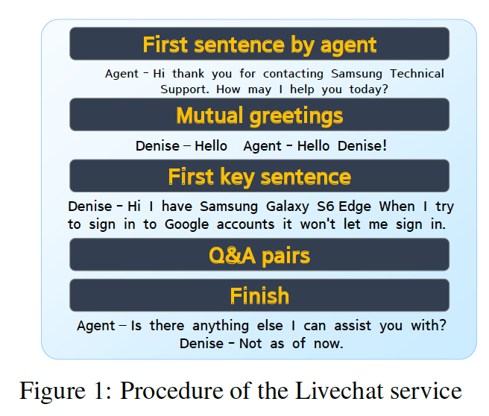
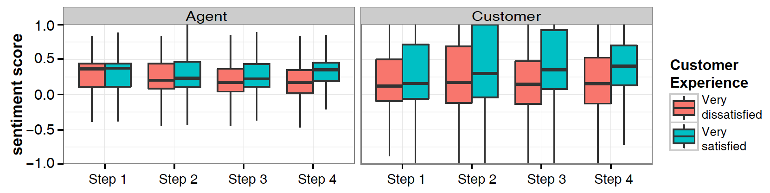
Mining the Minds of Customers from Online Chat Logs (2015)
Abstract
This study investigates factors that may determine satisfaction in customer service operations.
We utilized more than 170,000 online chat sessions between customers and agents to identify characteristics of chat sessions that incurred dissatisfying experience.
Quantitative data analysis suggests that sentiments or moods conveyed in online conversation are the most predictive factor of perceived satisfaction.
Feature Extraction
we extracted a total of 14 features for each chat steps across the following:
session-level meta information (e.g., number of utterances, session length of a session)
agent’s sentiment (e.g., agent’s sentiment at each step)
customer’s sentiment (e.g., customer’s sentiment at each step).
Kunwoo Park, Jaewoo Kim, Jaram Park, Meeyoung Cha
CIKM’15, October 19-23, 2015, Melbourne, VIC, Australia

Slide 5
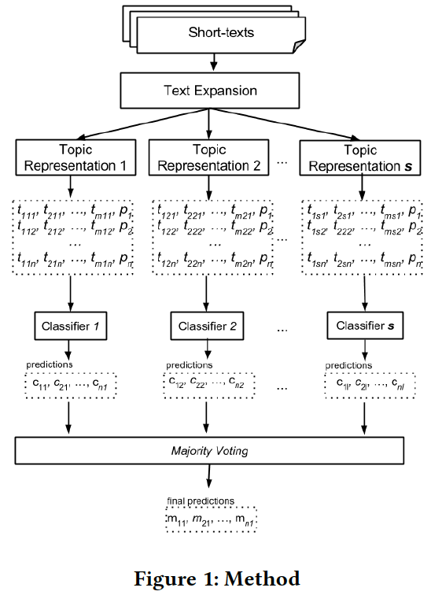
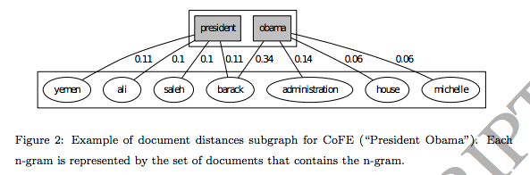
A Majority Voting Approach for Sentiment Analysis in Short Texts using Topic Models (2017)
Abstract
Nowadays people can provide feedback on products and services on the web.
We propose a new sentiment analysis method that uses topic models to infer the polarity of short texts.
by using topics, the classifier is able to better understand the context and improve the performance in this task.
In this method, we combine the results of classifiers and text representations in two ways:
(1) by using single topic representation and multiple classifiers;
(2) using multiple topic representations and a single classifier.
Topic Representation
LDA, MedLDA, BTM
Classifier
Linear SVM, Logistic Regression, Random Forest
Text Expansion
In order to identify topics in short texts, it is important to perform a text expansion. We used the DREx method in order to make the expansion.
Rodrigo Rodrigues do Carmo, Anísio Mendes Lacerda, Daniel Hasan Dalip
WebMedia ’17, October 17–20, 2017, Gramado, Brazil

Slide 6
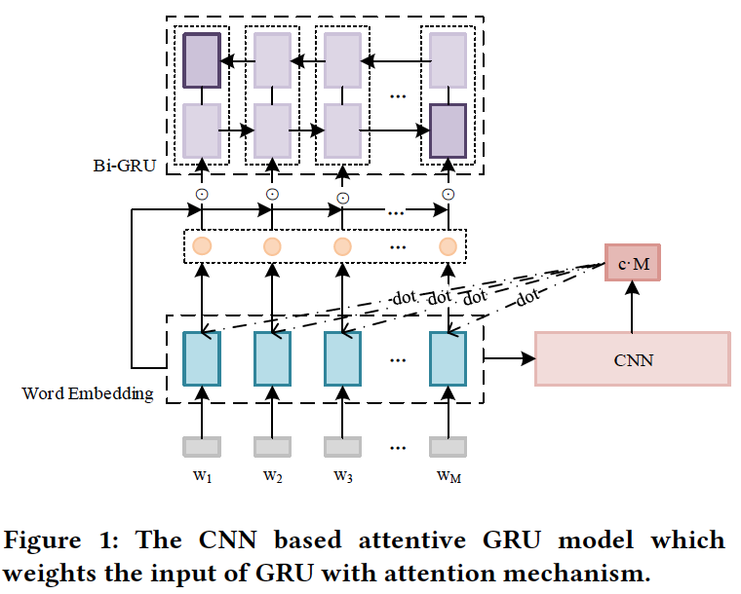
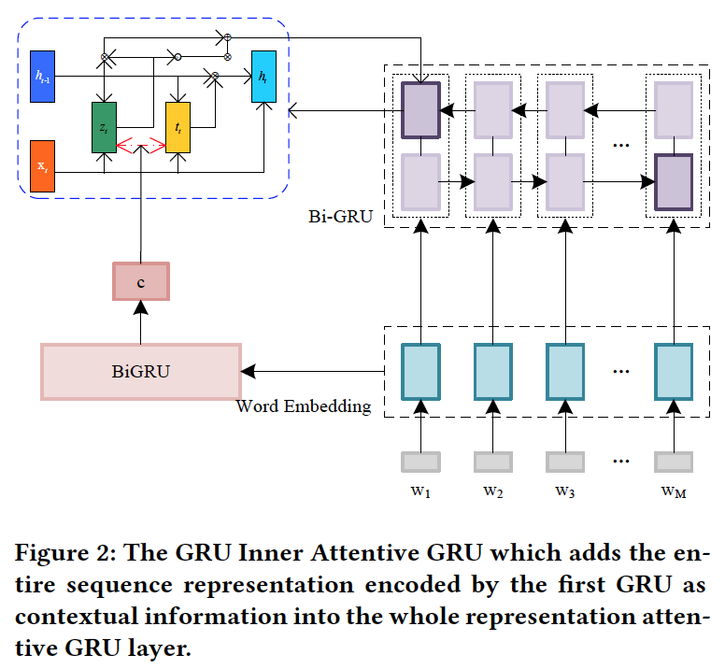
Entire Information Attentive GRU for Text Representation (2018)
Abstract
Recurrent Neural Networks (RNNs), such as Long Short-Term Memory (LSTM) and Gated Recurrent Unit (GRU), have been widely utilized in sequence representation. However, RNNs neglect variational information and long-term dependency.
In this paper, we propose a new neural network structure for extracting a comprehension sequence embedding by handling the entire representation of the sequence
To evaluate our proposed methods, we conduct extensive experiments on a benchmark sentiment classification dataset.
Guoxiu He, Wei Lu
ICTIR ’18, September 14–17, 2018, Tianjin, China

Slide 7
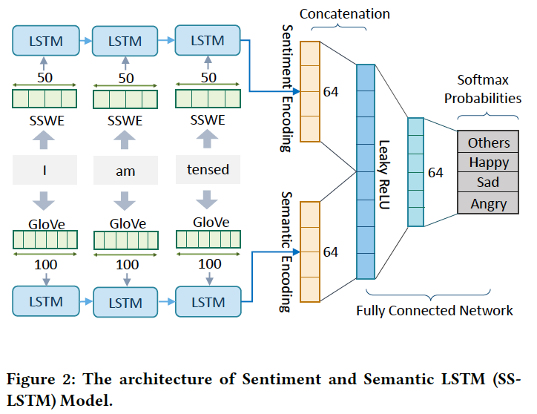
A Sentiment-and-Semantics-Based Approach for Emotion Detection in Textual Conversations (2018)
Abstract
In this paper, we propose a novel approach to detect emotions like happy, sad or angry in textual conversations using an LSTM based Deep Learning model.
Our approach consists of semi-automated techniques to gather training data for our model.
We exploit advantages of semantic and sentiment based embeddings and propose a solution combining both.
Dataset
used the Twitter Firehose to extract these 3 turn conversations
Label
Showed the third turn of the conversation along with the context of the previous 2 turns to human judges and asked them to mark the emotion of the third turn after considering the context.
Umang Gupta, Ankush Chatterjee, Radhakrishnan Srikanth, Puneet Agrawal
Neu-IR ’17, August 11, 2017, Shinjuku, Tokyo, Japan

Slide 8
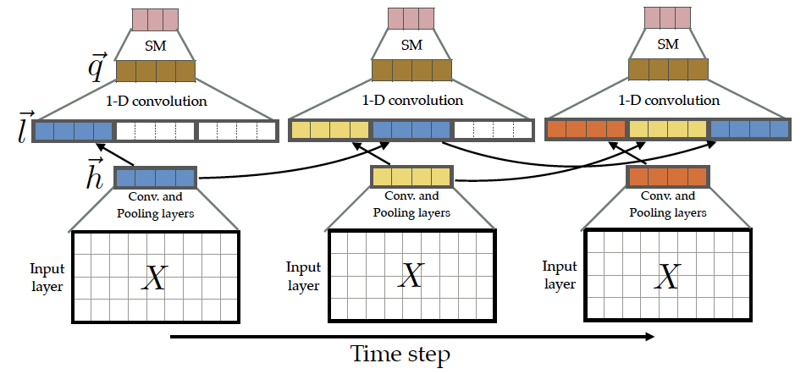
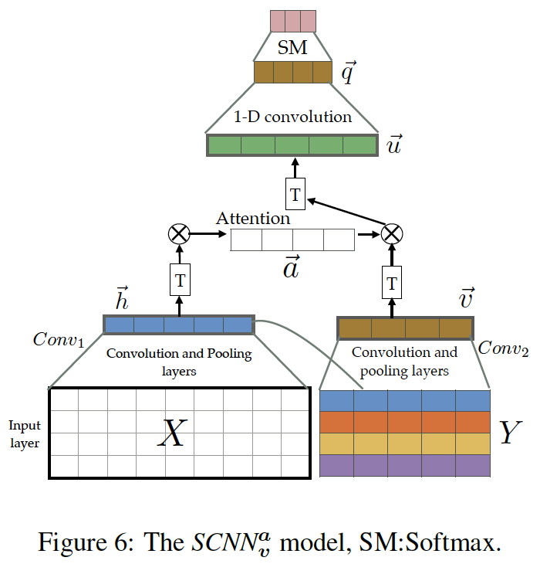
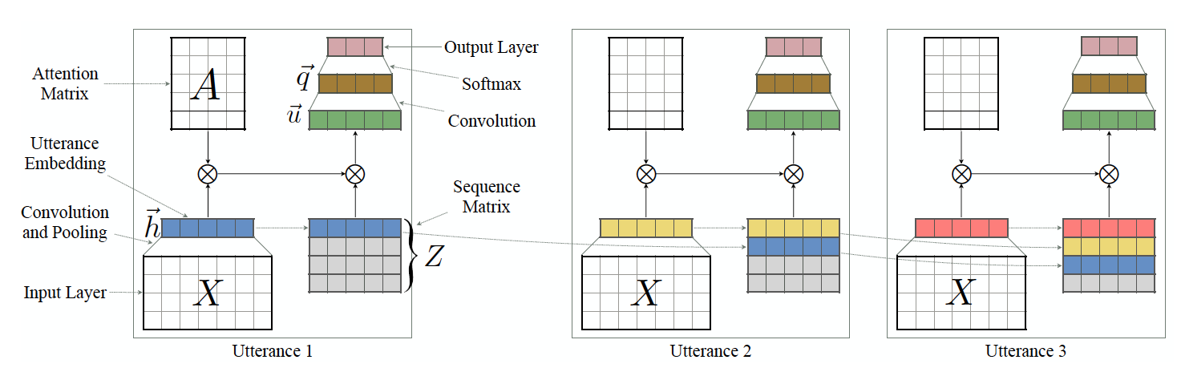
Emotion Detection on TV Show Transcripts with Sequence-based Convolutional Neural Networks (2017)
Abstract
This paper introduces a corpus for text-based emotion detection on multiparty dialogue as well as deep neural models that outperform the existing approaches for document classification.
We then suggest four types of sequence-based convolutional neural network models with attention that leverage the sequence information encapsulated in dialogue.
Sayyed M. Zahiri, Jinho D. Choi
arXiv:1708.04299v1 [cs.CL] 14 Aug 2017

Slide 9
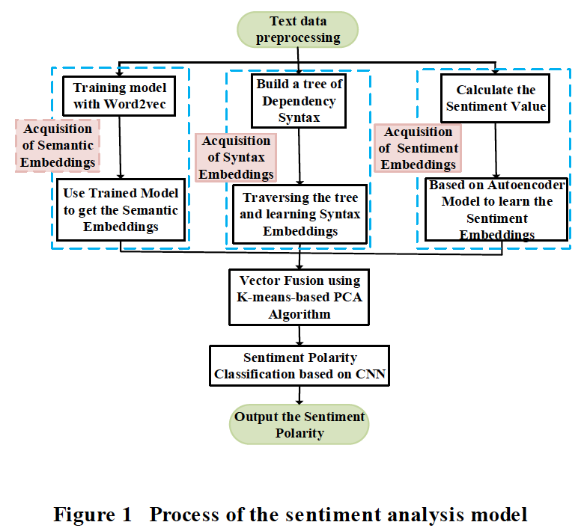
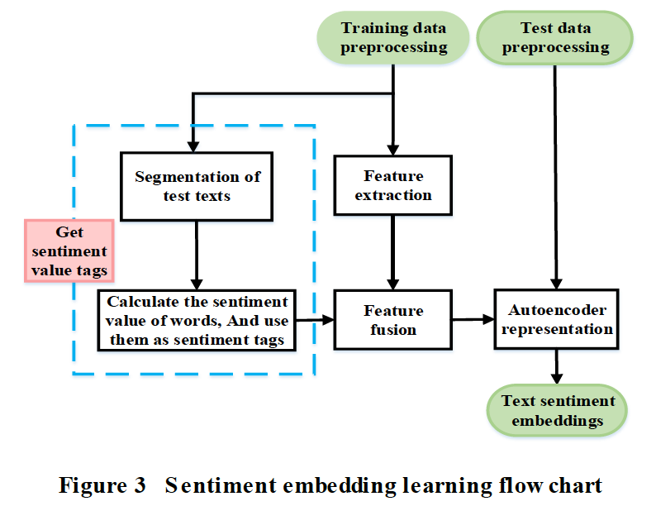
Text Sentiment Polarity Classification Method Based on Word Embedding (2018)
Abstract
Word embedding of word2vec training contains only semantic information.
An algorithm for text sentiment analysis is proposed solve the problem of text containing semantics, syntax, sentiment and other information.
It begins with the learning of original text-multi word embedding in the semantic, syntactic, and sentiment information, followed by proceeding the word embedding fusion.
The improved convolution neural network is applied for sentiment analysis.
K-means text clustering is applied by dividing similar text into the same cluster, thus improving the classification accuracy.
The application of the Principal Component Analysis (PCA) dimensionality not only extracts the principal component information, but also solves the problem of redundancy embedding and improves the computational performance of classification model.
Xiaojie Sun, Menghao Du, Hua Shi, Wenming Huang
ICACS '18, July 27–29, 2018, Beijing, China

Slide 10
Deep Learning Approach for Sentiment Analysis of Short Texts (2017)
Abstract
Learning long-term dependencies with gradient descent is difficult in neural network language model because of the vanishing gradients problem.
In this paper, we propose ConvLstm, neural network architecture that employs Convolutional Neural Network (CNN) and Long Short-Term Memory (LSTM) on top of pre-trained word vectors.
In our experiments, ConvLstm exploit LSTM as a substitute of pooling layer in CNN to reduce the loss of detailed local information and capture long term dependencies in sequence of sentences.
Abdalraouf Hassan, Ausif Mahmood
2017 3rd International Conference on Control, Automation and Robotics

Slide 11
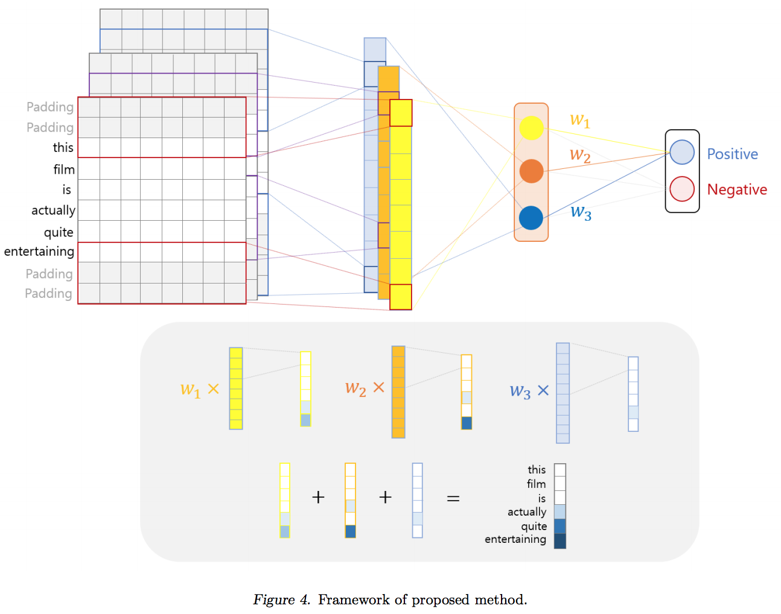
Sentiment Classification with Word Attention based on Weakly Supervised Learning with a Convolutional Neural Network (2017)
Abstract
In this paper, we propose a method for identifying key words discriminating positive and negative sentences by using a weakly supervised learning method based on a convolutional neural network (CNN).
In our model, each word is represented as a continuous-valued vector and each sentence is represented as a matrix whose rows correspond to the word vector used in the sentence. Then, the CNN model is trained using these sentence matrices as inputs and the sentiment labels as the output.
Once the CNN model is trained, we implement the word attention mechanism that identifies high-contributing words to classification results with a class activation map, using the weights from the fully connected layer at the end of the learned CNN model.
Gichang Lee, Jaeyun Jeong, Seungwan Seo, CzangYeob Kim, Pilsung Kang
arXiv:1709.09885v2 [cs.CL] 29 Sep 2017

Slide 12
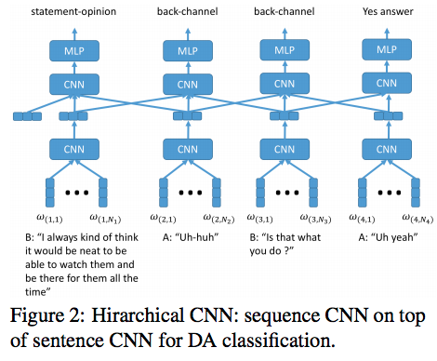
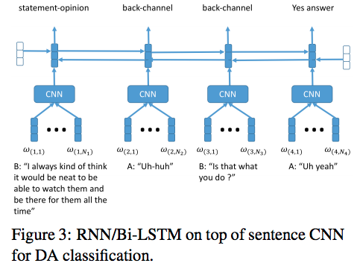
Using Context Information for Dialog Act Classification in DNN Framework (2018)
Abstract
A few recent studies explored using deep learning neural networks for DA classification, however, it is not clear yet what is the best method for using dialog context or DA sequential information, and how much gain it brings.
Our proposed methods include using hierarchical models (recurrent neural networks (RNN) or CNN) for DA sequence tagging
Yang Liu, Kun Han, Zhao Tan, Yun Lei
Proceedings of the 2017 Conference on Empirical Methods in Natural Language Processing

Slide 13
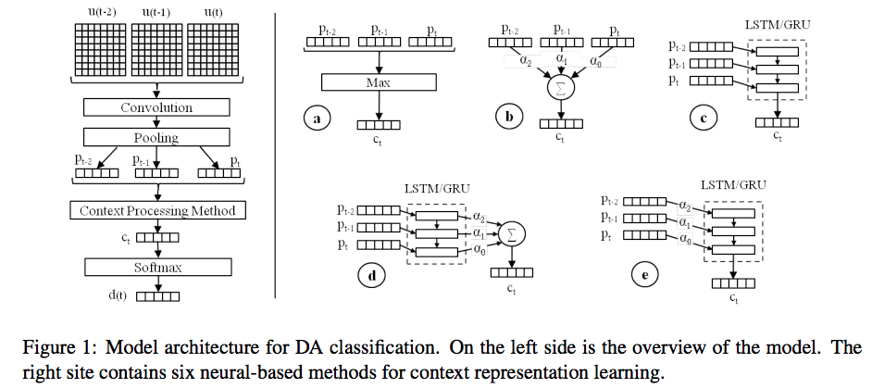
Neural-based Context Representation Learning for Dialog Act Classification (2017)
Abstract
We explore context representation learning methods in neural-based models for dialog act classification.
We propose and compare extensively different methods which combine recurrent neural network architectures and attention mechanisms (AMs) at different context levels.
Daniel Ortega Ngoc Thang Vu
arXiv:1708.02561v1 [cs.CL] 8 Aug 2017

Slide 14
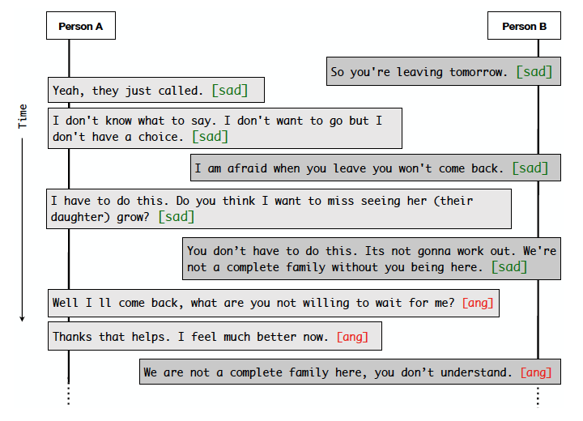
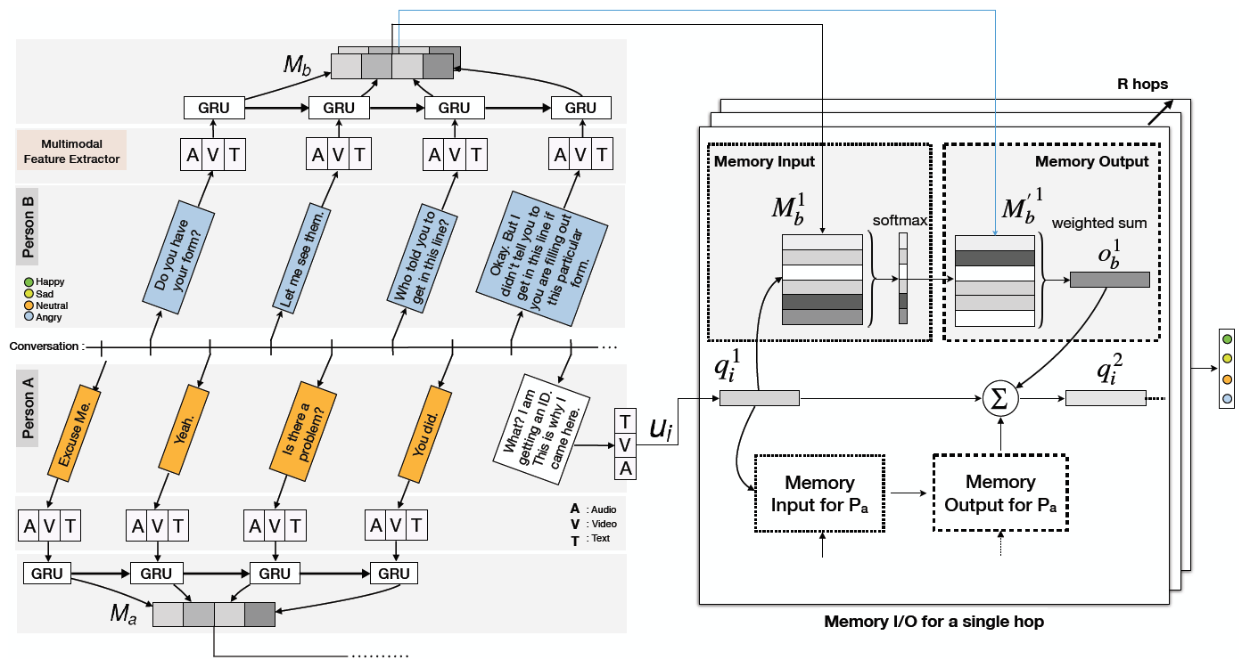
Conversational Memory Network for Emotion Recognition in Dyadic Dialogue Videos (2018)
Abstract
Present methods mostly ignore the role of inter-speaker dependency relations while classifying emotions in conversations.
In this paper, we address recognizing utterance-level emotions in dyadic conversational videos.
We propose a deep neural framework, termed conversational memory network, which leverages contextual information from the conversation history.
The framework takes a multimodal approach comprising audio, visual and textual features with gated recurrent units to model past utterances of each speaker into memories.
Textual Feature
To get our sentence representation, we use a simple CNN with one convolutional layer followed by max-pooling (Kim, 2014; Poria et al., 2016).
Devamanyu Hazarika, Soujanya Poria, Amir Zadeh, Erik Cambria, Louis-Philippe Morency, Roger Zimmermann
Proceedings of NAACL-HLT 2018, pages 2122–2132

Slide 15
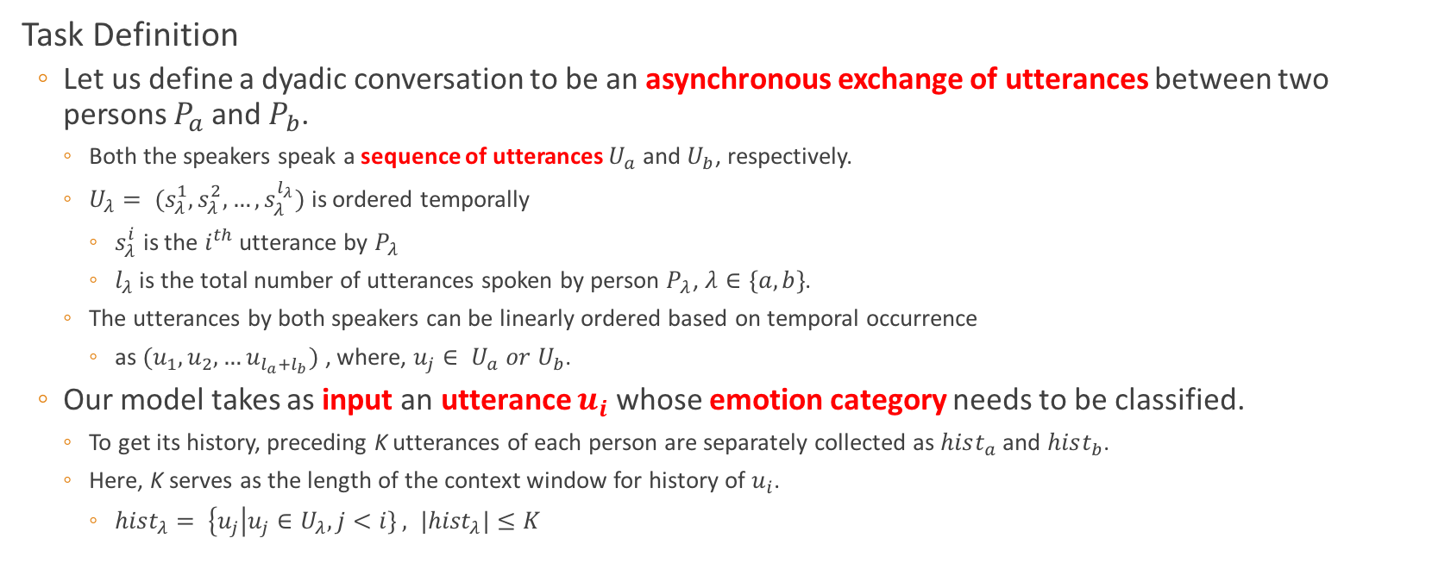
Conversational Memory Network for Emotion Recognition in Dyadic Dialogue Videos (2018)
Task Definition
Let us define a dyadic conversation to be an asynchronous exchange of utterances between two persons $P_{a}$ and $P_{b}$.
Both the speakers speak a sequence of utterances $U_{a}$ and $U_{b}$, respectively.
$U_{λ}= (s_{λ}^{1}, s_{λ}^{2}, …, s_{λ}^{l_{λ}})$ is ordered temporally
$s_{λ}^{i}$ is the $i^{th}$ utterance by $P_{λ}$
$l_{λ}$is the total number of utterances spoken by person $P_{λ}$, $λ∈\{a, b\}$.
The utterances by both speakers can be linearly ordered based on temporal occurrence
as $(u_{1}, u_{2}, …u_{l_{a}+l_{b}})$ , where, $u_{j}∈ U_{a} or U_{b}$.
Our model takes as input an utterance $u_{i}$ whose emotion category needs to be classified.
To get its history, preceding K utterances of each person are separately collected as $hist_{a}$and $hist_{b}$.
Here, K serves as the length of the context window for history of $u_{i}$.
$hist_{λ}= \left\{u_{j}\right|u_{j}∈U_{λ}, j<i\} , |{hist}_{λ}|≤K$

Slide 16
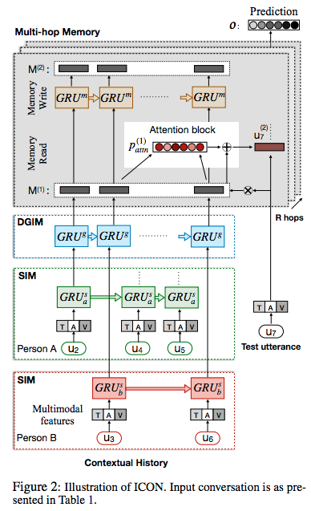
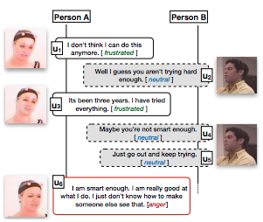
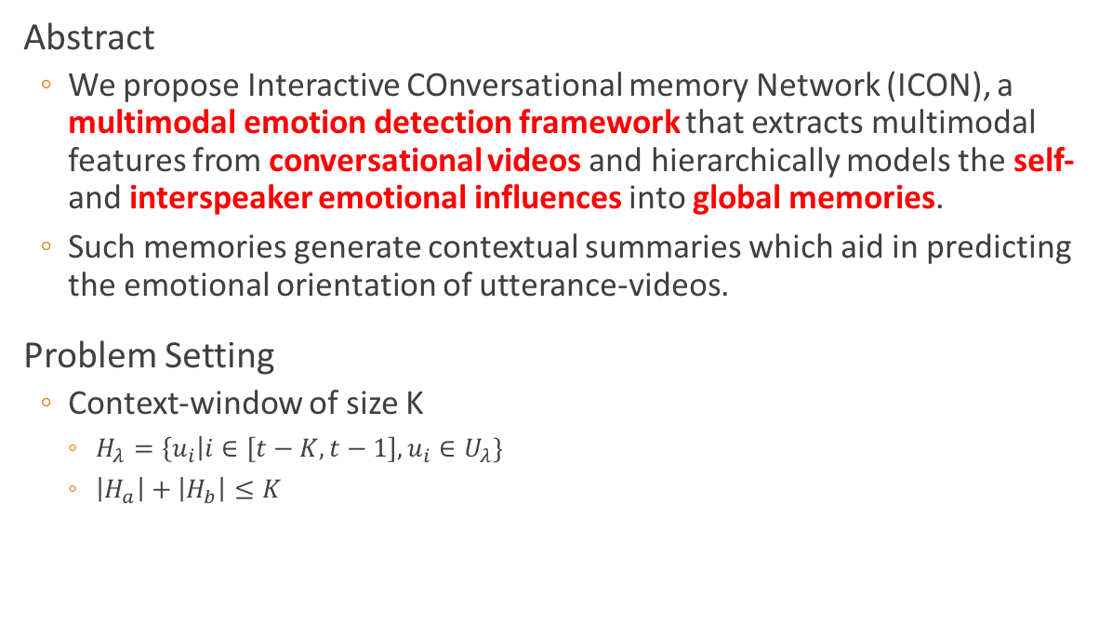
ICON: Interactive Conversational Memory Network for Multimodal Emotion Detection (2018)
Abstract
We propose Interactive COnversational memory Network (ICON), a multimodal emotion detection framework that extracts multimodal features from conversational videos and hierarchically models the self- and interspeaker emotional influences into global memories.
Such memories generate contextual summaries which aid in predicting the emotional orientation of utterance-videos.
Problem Setting
Context-window of size K
$H_{λ}=\left\{u_{i}\right|i∈\left[t−K, t−1\right], u_{i}∈U_{λ}\}$
$\left|H_{a}\right|+\left|H_{b}\right|≤K$
Devamanyu Hazarika, Soujanya Poria, Rada Mihalcea, Erik Cambria and Roger Zimmermann
Proceedings of the 2018 Conference on Empirical Methods in Natural Language Processing, pages 2594–2604

Slide 17
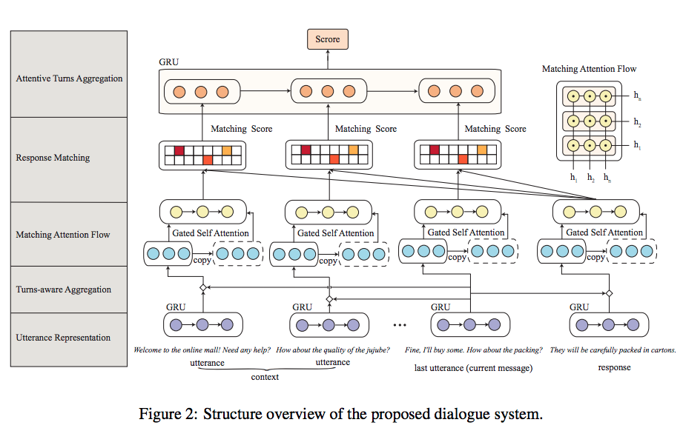
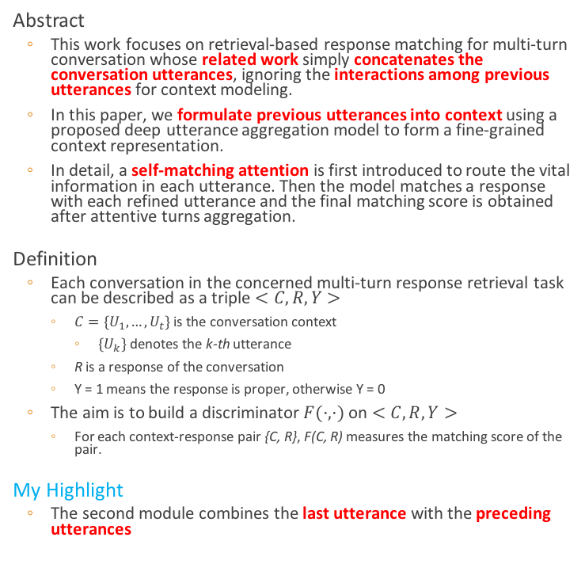
Modeling Multi-turn Conversation with Deep Utterance Aggregation (2018)
Abstract
This work focuses on retrieval-based response matching for multi-turn conversation whose related work simply concatenates the conversation utterances, ignoring the interactions among previous utterances for context modeling.
In this paper, we formulate previous utterances into context using a proposed deep utterance aggregation model to form a fine-grained context representation.
In detail, a self-matching attention is first introduced to route the vital information in each utterance. Then the model matches a response with each refined utterance and the final matching score is obtained after attentive turns aggregation.
Definition
Each conversation in the concerned multi-turn response retrieval task can be described as a triple $<C, R, Y>$
$C=\{U_{1}, …, U_{t}\}$ is the conversation context
$\{U_{k}\}$ denotes the k-th utterance
R is a response of the conversation
Y = 1 means the response is proper, otherwise Y = 0
The aim is to build a discriminator $F(·, ·)$ on $<C,R,Y>$
For each context-response pair {C, R}, F(C, R) measures the matching score of the pair.
My Highlight
The second module combines the last utterance with the preceding utterances
Zhuosheng Zhang, Jiangtong Li, Pengfei Zhu, Hai Zhao, Gongshen Liu
Proceedings of the 27th International Conference on Computational Linguistics, pages 3740–3752

Slide 18
方法总结
不区分回合的发言
提取特征，以简单机器学习算法作为分类器
Emotion Analysis of Internet Chat (2008)
A Majority Voting Approach for Sentiment Analysis in Short Texts using Topic Models (2017)
以RNN/CNN把整句话映射成隐藏特征分量，再以全连接映射到标签
Semi-supervised Sentiment Classification with Dialog Data (2018)
Entire Information Attentive GRU for Text Representation (2018)
A Sentiment-and-Semantics-Based Approach for Emotion Detection in Textual Conversations (2018)
Text Sentiment Polarity Classification Method Based on Word Embedding (2018)
Deep Learning Approach for Sentiment Analysis of Short Texts (2017)
Sentiment Classification with Word Attention based on Weakly Supervised Learning with a Convolutional Neural Network (2017)

Slide 19
方法总结
区分回合的发言
每个发言者的每回合发言先映射到一个固定大小的向量
两个发言者的每回合发言走同一个通道
把上下文的特征向量按时间顺序直接拼在一起
Mining the Minds of Customers from Online Chat Logs (2015)
Emotion Detection on TV Show Transcripts with Sequence-based Convolutional Neural Networks (2017)
把上下文的特征以CNN/RNN结合
Using Context Information for Dialog Act Classification in DNN Framework (2018)
把上下文的特征以Attention结合
Neural-based Context Representation Learning for Dialog Act Classification (2017)
其他
Modeling Multi-turn Conversation with Deep Utterance Aggregation (2018)
两个发言者的每回合发言分别走不同通道后再融合
Conversational Memory Network for Emotion Recognition in Dyadic Dialogue Videos (2018)
ICON: Interactive Conversational Memory Network for Multimodal Emotion Detection (2018)

